Slide 1

Towards a Breakthrough in
Automatic Speech Recognition
Hiroya Fujisaki
Professor Emeritus, University of Tokyo

Slide 2
OUTLINE
1. Introduction – State of Art in ASR
2. Spoken Language versus Written Language
3. Problems in the Basic Assumptions of Statistical ASR
4. Beyond Statistical Methods
5. An Example: User Modeling in a Spoken Dialogue System — A Preliminary Model of Mind
6. From Mind to Mind — the Ultimate Goal of Spoken Language Processing
© Hiroya Fujisaki

Slide 3
The Roles of Speech and Text in the Age of Information Society
・ Efficient medium for human communication
・ Important medium for human-machine
communication
・ Important medium for human-to-human
communication mediated by machines
© Hiroya Fujisaki

Slide 4
Four Major Tasks for the Machines
Text-to-Speech (TTS)
Text
Machine
Speech
2. Speech-to-Text (ASR)
Speech
Machine
Text
Speech
in L1
Machine
Speech
in L2
3. Speech-to-Speech
(Interpreting Telephony)
4. Text-to-Text (MT)
Text
in L1
Machine
Text
in L2
© Hiroya Fujisaki

Slide 5
Trends in the Developments of ASR
Feature-Based Methods
Template-Matching Methods
Rule-Based Methods
Statistical Methods
© Hiroya Fujisaki

Slide 6
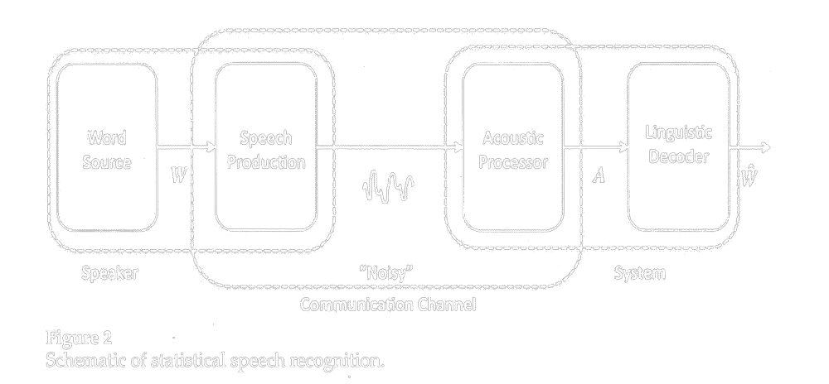

Schematic of statistical speech recognition (Jelinek,1976)
“Noisy” Communication Channel
Speaker
ASR System
1.
Speech
Produc-
tion
Word
Source
Acoustic
Processor
Linguistic
Decoder
Language
speech
Language
W : a string of words
A : acoustic signal observed by the recognizer
S : set of sentences that can be generated
© Hiroya Fujisaki

Slide 7
Statistical speech recognition - continued
W : a string of words
A : acoustic signal observed by the recognizer
S : set of sentences that can be generated
P(A|W) : the acoustic model
P(W) : the language model
︿
︿
© Hiroya Fujisaki

Slide 8
State of Art in ASR --- Examples of Limitations of Current Technologies (e.g., C.-H. Lee, 2003)
Summary of Performance for Speaker-independent Recognition of
Fluent Speech — Laboratory Evaluations
Task (Grammar) Perplexity Vocabulary Size WER
RM (word-pair) 60 991 words 3.0%
ATIS (bigram) 25 1,800 words 3.0%
WSJ (trigram) 145 20,000 words 12.0%
For more realistic tasks, such as the Switchboard and
CallHome tasks, WERs increase to more than 40%,
making the technology not appropriate for real-world
applications.

Slide 9
F. Jelinek in 2009
The statistical approach is clearly dominant. ….
Although we have made significant progress, we are very far from solving the problem.
© Hiroya Fujisaki

Slide 10
Spoken Language vs. Written Language
Conventional Concepts: Language vs. Speech
“Language” is the underlying code system common to
both speech and text.
“Speech” is the acoustic signal carrying the information
of the language.
New Concepts (Fujisaki, 1986）：
Spoken Language vs. Written Language
“Speech” and “Text” are physical signals but also serve
as different code systems. The information they carry
are not identical.
“Spoken Language” refers to both the signal and the
code system. The same applies to “Written Language.”
© Hiroya Fujisaki

Slide 11
Examples of Differences Between SL and WL as Code Systems
Difference in ambiguity:
Many expressions exist that are ambiguous in WL
but are unambiguous in SL, and vice versa; e.g.,
homonymity and homographism at the lexical level.
Homographism (ambiguous in WL but not in SL)
English: close, content, interest, increase, present,
record, recreation, wind, etc.
Homonymity (ambiguous in SL but not in WL)
English: flower/flour, knight/night, made/maid,
pray/prey, right/write, steal/steel, etc.
1.
© Hiroya Fujisaki
FRSM 2011 (2011-03-09)

Slide 12
Examples of Differences Between SL and WL as Code Systems
2. Prosody in SLs allows disambiguation of some of
the ambiguities (e.g., lexical and syntactic) in WLs.
Example: syntactic ambiguity in WL
old men and women old men and women
All the young men went to war, leaving only old
men and women at home.
(b) Old men and women are called senior citizens.
1.
(a)
(b)
© Hiroya Fujisaki
FRSM 2011 (2011-03-09)

Slide 13
Examples of Differences Between SL and WL as Code Systems
1.
3. Difference in word boundary marking
In many (but not all) WLs, word boundaries are explicitly shown, but not in SLs, causing ambiguity
in SL.
English: I scream / ice cream [aiskri:m]
an ice cream / a nice cream
[ənaiskri:m]
night rate / niterate [naitreit]
© Hiroya Fujisaki
FRSM 2011 (2011-03-09)

Slide 14
SL and WL are Different Code Systems
Certain kind/amount of linguistic information is
NOT shared by the Spoken Language (SL) and the Written Language (WL).
Hence they are two distinct systems for coding thelinguistic information.
Conversion of a message expressed in SL into a
message in WL (i.e., ASR) is only possible by
correctly inferring the information missing in the SL
message, and by expressing it in the WL message.
The same is true for conversion of a WL message
into an SL message.
1.
© Hiroya Fujisaki
FRSM 2011 (2011-03-09)

Slide 15
Re-examination of Some of the Basic Assumptions of Statistical Speech Recognition
“Noisy” Communication Channel
Speaker
ASR System
1.
Speech
Produc-
tion
Word
Source
Acoustic
Processor
Linguistic
Decoder
1. Is the speaker model true?
2. Is the noisy communication channel model valid?
3. Is the language model sufficiently accurate?
© Hiroya Fujisaki
FRSM 2011 (2011-03-09)

Slide 16
1. Is the speaker model true? ー No.
“Noisy” Communication Channel
ASR System
Speaker
1.
Word
Source
Speech
Produc-
tion
Acoustic
Processor
Linguistic
Decoder
W
︿
W
Since W is the estimated output （string of words in the written
language), the input W must also be a message in the written
language. Hence this scheme shows a situation where the
speaker is given a text (by someone else) and reads it aloud.
︿
© Hiroya Fujisaki
FRSM 2011 (2011-03-09)

Slide 17
What does a speaker do?
“Noisy” Communication Channel
Speaker
ASR System
1.
Understanding W
and
Generating S
Word
Source
Speech
Produc-
tion
Acoustic
Processor
Linguistic
Decoder
W
S
︿
W
︿
W
The speaker’s functions are:
1. Understanding the input message W in the written language.
(Reading W aloud is possible only after understanding it.)
2. Generating the message S in the spoken language.
© Hiroya Fujisaki
FRSM 2011 (2011-03-09)

Slide 18
2. Is the noisy communication channel model valid?
ー No.
Channel with Degeneration
Speaker
ASR System
1.
Understanding W
and
Generating S
Word
Source
Speech
Produc-
tion
Acoustic
Processor
Linguistic
Decoder
W
S
︿
W
︿
W
Since conversion of a written language message W into a spoken
language message S entails ambiguity of various origin (lexical,
syntactic, etc.) that cannot be restored by statistical inference,
the whole process cannot be regarded as a simple noisy channel.
© Hiroya Fujisaki
FRSM 2011 (2011-03-09)

Slide 19
3. Is the language model sufficiently accurate?
ー No.
Channel with Degeneration
Speaker
ASR System
1.
Understanding W
and
Generating S
Word
Source
Speech
Produc-
tion
Acoustic
Processor
Linguistic
Decoder
W
S
︿
W
︿
W
Since a bigram (simple Markov) model is regarded insufficient
for representing syntactic relationships between words, it has
become a common practice to use trigram (second-order Markov)
model as the language model. But trigram is still not good enough.
© Hiroya Fujisaki
FRSM 2011 (2011-03-09)

Slide 20
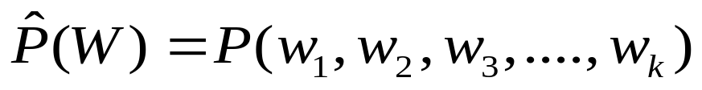
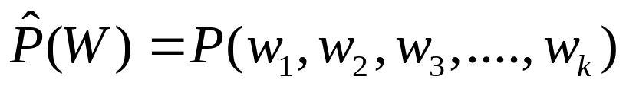
Use of Trigram for the Language Model
Simple Markov Model = Bigram Model
For a thousand word vocabulary, measurement of bigram probablity
needs to examine occurrences of each of one million bigrams.
Second-order Markov Model = Trigram Model
For a thousand word vocabulary, measurement of trigram probablity
needs to examine occurrences of each of one billion trigrams.
Since data is not enough, smoothing is introduced, but the validity is
not guaranteed. Still, trigram is a very poor model for syntax.
© Hiroya Fujisaki
FRSM 2011 (2011-03-09)

Slide 21
Use of N-grams for N > 3 is impossible
Theoretically, it should be possible to achieve higher
degree of approximation if we increase N indefinitely.
Data required for an N-gram model in the case of
a modest vocabulary size of 1000 words
N No. of entries
Bigram model 10⁶
Trigram model 10⁹
4-gram model 10¹²
Thus it is apparent that we cannot go beyond N = 3.
© Hiroya Fujisaki
FRSM 2011 (2011-03-09)

Slide 22
Summary of Limitations of the Statistical Approach
1.
The statistical approach is limited since
it does not make distinction between the spoken language and the written language
the noisy communication channel model does not approximate the situation involving ambiguity
it is impossible to use higher-order statistics beyond word trigrams.
© Hiroya Fujisaki
FRSM 2011 (2011-03-09)

Slide 23
From Speech and Natural Language Processing to Spoken Language Processing
Conventional Approach:
• Speech as a signal Speech (Signal) Processing
• Language as a code Natural Language Processing (NLP)
NLP has been dealing exclusively with written languages.
However, the units, structures and functions of the spoken
language are different from those of the written language.
Proposed Approach (Fujisaki, 1986):
Spoken Language Processing as a unified field
to deal with both (signal and code) aspects of speech
as distinct from Written Language Processing.
© Hiroya Fujisaki

Slide 24
Historical Background of SLP
April 1987 - Initiation of the Japanese National Project on
Advanced Human-Machine Interface Through Spoken Language
(Project Leader: H.Fujisaki)
Jan. 1988 - First Symposium held in Tokyo
Jun. 1988 - HF invited to DARPA Workshop, and DARPA re-defines the
goal of one of its project to be “Spoken Language Systems”
Dec. 1988 - Second Symposium held in Hawaii, attended by
many leading researchers from all over the world
Jan. 1990 - Third Symposium held in Tokyo
Nov. 1990 - First Int’l Conference on Spoken Language
Processing (ICSLP) held in Kobe, Japan
(HF as the founder chairman)
© Hiroya Fujisaki

Slide 25
World-wide Acceptance of the Terms: SL, SLP, SLS
Immediately after the DARPA workshop in June 1988 In Pittsburgh,
where DARPA re-defined one of its goals to be Spoken Language
Systems, a number of institutions and laboratories were established
or re-named to include SL, SLP, and SLS in their names, e.g.,
- Spoken Language Systems Laboratory, at MIT,
- Spoken Language Systems Laboratory at INESC-ID Lisbon,
- Spoken Language Systems Group at SRI, etc.,
- Groupe Traîtement du Language Parlé at LIMSI – CNRS,
- Center for Spoken Language Research at Univ. Colorado,
- EAGLES Spoken Language Working Group,
- MS/CSE: Spoken Language Systems, given at Oregon HSU.
© Hiroya Fujisaki

Slide 26
Limitations of Current Approaches in ASR
1. Lack of true recognition of the fact that spoken languages
are essentially different from written languages,
not only in their forms, but also in their functions
2. Based on Shannon’s communication channel model
which does not go beyond the language model
3. Failure to recognize that we can and should learn
much more from the human processes,
in so far as the latter are much superior to
artificial systems
© Hiroya Fujisaki

Slide 27
Spoken Language versus Written Language (1)
SL: While a word can be pronounced clearly as a sequence
of sounds in an isolated utterance, these sounds
heavily overlap with each other, and some of them may
be greatly reduced or totally omitted in an ordinary
discourse, without impairing communication at all.
(Pronunciation variations)
WL: Such overlaps, reductions and omissions of small
units are usually not present, and are hardly
acceptable if they were present.
Human speech perception does not always need
recognition of segments.
© Hiroya Fujisaki

Slide 28
Spoken Language versus Written Language (2)
There are a number of lexical items that appear only in SL,
but not in WL. In some cases, they are abbreviated and/or
concatenated versions of their counterparts in the lexicon
of WL, but in many other cases they have no counterparts
in the lexicon of WL.
a) Abbreviated/concatenated versions of WL lexical items
- used only in fast and casual utterances
b) Lexical items that are only in SL
- used even in normal, slow and careful utterances
c) Some new words appear first in SL
- needs time to be accepted in the lexicon of WL
Hence the lexicon for SL is different from
that for WL.
© Hiroya Fujisaki

Slide 29
Spoken Language versus Written Language (3)
Word order is far more flexible in SL than in WL.
What is ungrammatical (i.e., ill-formed) in WL is
perfectly acceptable (not ill-formed) in SL.
However, there are constraints on the allowable
word order.
Hence the grammar of SL is different
from that of WL.
© Hiroya Fujisaki

Slide 30
Spoken Language versus Written Language (4)
SL can convey linguistic information that
cannot be conveyed by WL.
For instance, both lexical and syntactic
ambiguities of expressions in WL can be
often (but not always) disambiguated by
prosody in SL.
e.g., ‘record (noun)’ vs. ‘record (verb)’
‘old men and women’
Hence certain types of linguistic
information are expressed only by SL
© Hiroya Fujisaki

Slide 31
Spoken Language versus Written Language (5)
SL can convey, along with linguistic information,
further information on the intention, attitude,
physical and emotional states, as well as
idiosyncrasies of the speaker, while WL is quite
limited in its capacity for conveying such
information.
It is often called ‘Intonational Meaning.’
However, it is not linguistic in the strict sense,
so that this expression is not quite appropriate.
Need for new concepts/definitions
© Hiroya Fujisaki

Slide 32
Spoken Language versus Written Language (6)
SL: The signal to be processed is generated by a human
speaker, and the process of generation as well as the
identity of the speaker are essential in endowing the
signal with the information to be conveyed.
WL: The signal to be processed is a printed text in
practically all the cases, and it is hardly questioned
how and by whom it is generated.
Need for understanding the human processes
of production
© Hiroya Fujisaki

Slide 33
Spoken Language versus Written Language (7)
SL: The signal is perceived and decoded by a human
listener, and the process of perception, decoding,
as well as the knowledge utilized in the process of
decoding are essential in retrieving the information.
WL: The signal to be processed is a printed text in
practically all the cases, and it is hardly questioned
how and by whom it is read.
Need for understanding the human processes
of perception
© Hiroya Fujisaki

Slide 34
Which Should Come First in ASR,
Recognition or Understanding?
Almost all the existing speech understanding systems are based on the premise that Recognition is the prerequisite to Understanding.
However, consider the following:
In Speech Synthesis from Text (Written Language to Spoken Language)
- One has to fully understand the text before one can read it correctly.
- Hence, Text Understanding must precede Speech Synthesis
In Speech Recognition (Spoken Language to Written Language)
- One has to fully understand the spoken language
before one can write it down correctly.
- Hence, Speech Understanding must precede Speech Recognition
© Hiroya Fujisaki

Slide 35
Human Recognition vs. Understanding
Understanding an utterance by a human is a top-down
process of inferring, from the result of a very rough
acoustic analysis, the entire message that is intended
by the speaker.
This is exactly the reason why speech communication
is possible in daily life with a lot of noise.
A spoken message is not really heard and recognized,
but is often inferred by the listener who believes that
he/she has actually heard it.
This is possible since the listener has a modelthe
the mind of the speaker.
© Hiroya Fujisaki

Slide 36
From Mind To Mind
The Ultimate Goal of Speech Science and Spoken Language Technology
Spoken Language as a Medium of
Communication Between Two Minds
2. Language Models Mind Models
3. Models of Speaker's Mind and
Listener‘s Mind
© Hiroya Fujisaki

Slide 37
From Language Models to Mind Models
Language Models
N-gram models, Markov models
Context-dependent models (local adaptation)
Topic-dependent models (global adaptation)
Speaker-dependent models (speaker adaptation)
Mind Models should comprise
Models of the speaker, the listener,
the situation, and the world.
© Hiroya Fujisaki

Slide 38
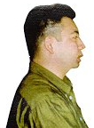




Information Retrieval Through Human-Machine Dialogue
Research on Human-Machine Dialogue Systems
Through Spoken Language
Conducted under the ‘Research for the Future’ Program
by the Japan Society for the Promotion of Science (1996 - 2001)
Project Leader: Hiroya Fujisaki (Science University of Tokyo)
Hello, can
you help me?
Yes, what kind
of articles do
you want?
SPOKEN
DIALOGUE
INTERNET
USER
SYSTEM
DATABASES
© Hiroya Fujisaki

Slide 39
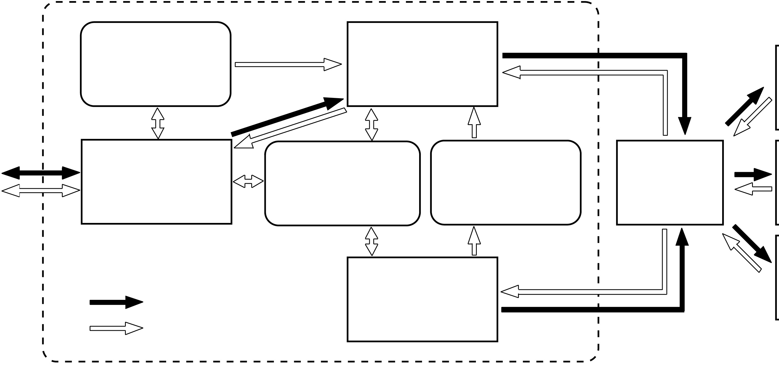
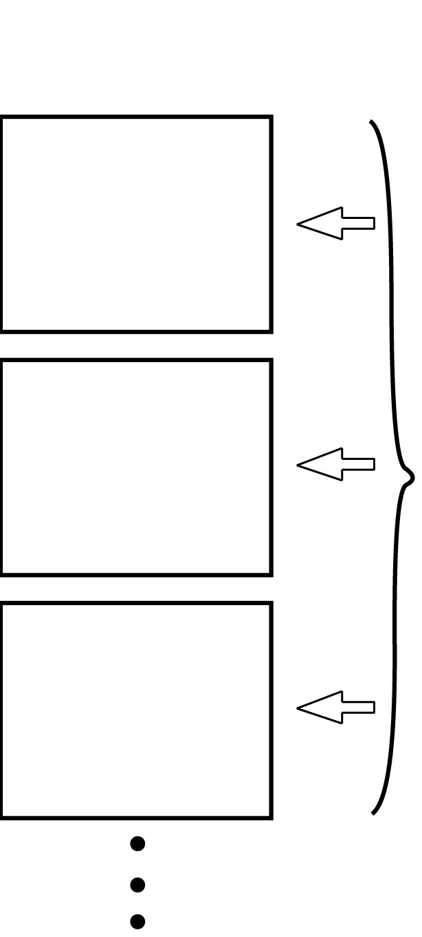
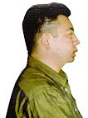
Overview of the System
Intelligent Information Retrieval System
Information on
・System
・Users
The Internet
Information
Retrieval
WWW
Module
Server
User
Interface
Module
Keyword
Keyconcept
Information on
Browser
FTP
Databases
Server
Databases
Lexicon
Information
Database
：Request
Acquisition
Server
User
：Information
Module
・User Interface Module (UIM) helps the user to clarify and state his/her query mainly through spoken dialogue, supplemented by a graphic user interface.
・Information Retrieval Module (IRM) conducts the actual task of I R.
・Information Acquisition Module (IAM) acquires knowledge on various databases available on the Internet, and stores it as link data concerning the address, relevant key concepts and keywords representing each database.
© Hiroya Fujisaki

Slide 40
Three Basic Principles
1. Dialogue Management Through
User and System Modeling
2. Information Retrieval Based on
Key Concepts (Fujisaki et al. 1984)
3. Relevance Estimation and
Performance Optimization
© Hiroya Fujisaki

Slide 41
Dialogue between User and System
・In many cases, a user is not fully aware, nor has
sufficient knowledge, of the information which he/she
wishes to retrieve.
・If the user and the system can exchange information
and knowledge through spoken dialogue, it will greatly
facilitate the process of formation and expression of
query on the part of the user, and also the process of
its clarification on the part of the system. Therefore,
1. The user can gradually formulate his/her intention
through dialogue with the system.
2. The system can easily understand user’s intention.
3. Questions can be answered immediately.
4. Problems can be solved without delay.
© Hiroya Fujisaki

Slide 42
From Dialogue Modeling to User/System Modeling
Conventional methods for dialogue management use
dialogue modeling
⇒fails to take the internal states of user/system into account
Some recent dialogue systems use only user modeling
⇒do not use system model, and fail to represent the
internal states of the system
One needs to model both the user and the system in order
to fully describe the dialogue as interaction between the two.
The current system manages the dialogue by modeling the
user and the system as interacting finite state automata.
© Hiroya Fujisaki

Slide 43
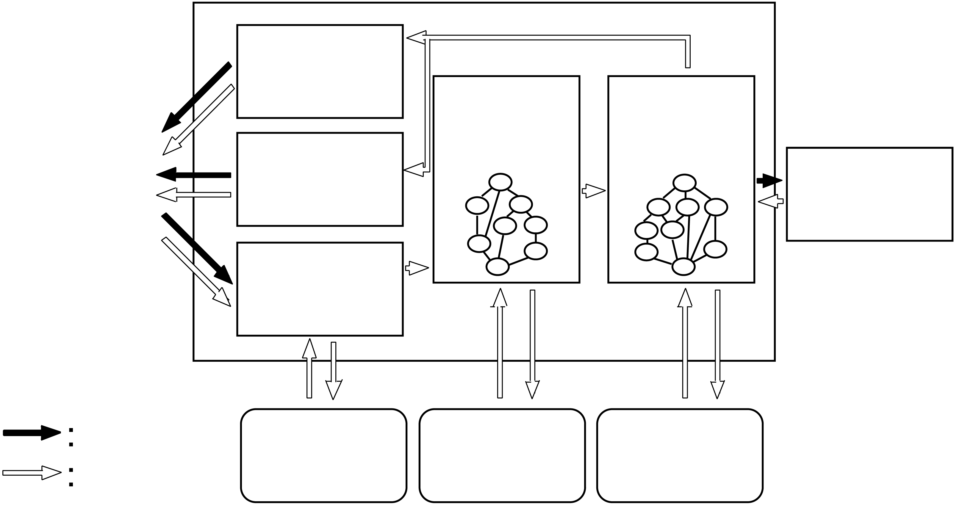
Schematic Diagram of the User Interface Module
User Interface Module (UIM)
Graphical
User
Interface
Speech
User
System
Information
Synthesis
Model
Model
Retrieval
Module
Speech
(IRM)
Understanding
Request
Information
Information
Lexicon
Information
on Users
on System
© Hiroya Fujisaki

Slide 44
Procedures for Model Construction
Construct a corpus of simulated dialogues
100 simulated dialogues, consisting of a total of 3,417 utterances,
were recorded by the method of ‘Wizard of OZ’, 10 speakers
playing the role of the system, and 7 playing the role of the user.
Classify all the utterances/actions into output types
(system’s output consists of both utterances to the user and
instructions to IRM), and infer the internal states of the user
and the system.
Number of output types: user:12 system:14
Number of states: user: 7 system: 8
Construct each model as a stochastic finite state automaton
whose state transitions are characterized by the quadruple:
① current state, ② input to current state, ③ next state(s),
and ④ output(s) produced at state transition, with transition
probability (probabilities).
© Hiroya Fujisaki

Slide 45
Formulation of a New Type of Finite State Automaton
X₂
X_{i} (input from another automaton )
S_{ij1}
Y_{ij1} , p_{ij1}
start
S₁
S₂
S_{i}
S_{ij2}
S_{n}
Y_{ijk}, p_{ijk}
State Transitions from S_{i}:
Input Output Next State Probability
X_{i1} Y_{i1j1} , S_{i1j1} , p_{i1j1} ;
Y_{i1j2} , S_{i1j2} , p_{i1j2} ;
Y_{i1jk} , S_{i1jk} , p_{i1jk} ;
X_{i2} Y_{i2j1} , S_{i2j1} , p_{i2j1} ;
….
S_{ijk}
…
Note:
Each user is modeled by a separate
automaton with a memory of his/her
past and current search, etc.
…
© Hiroya Fujisaki

Slide 46
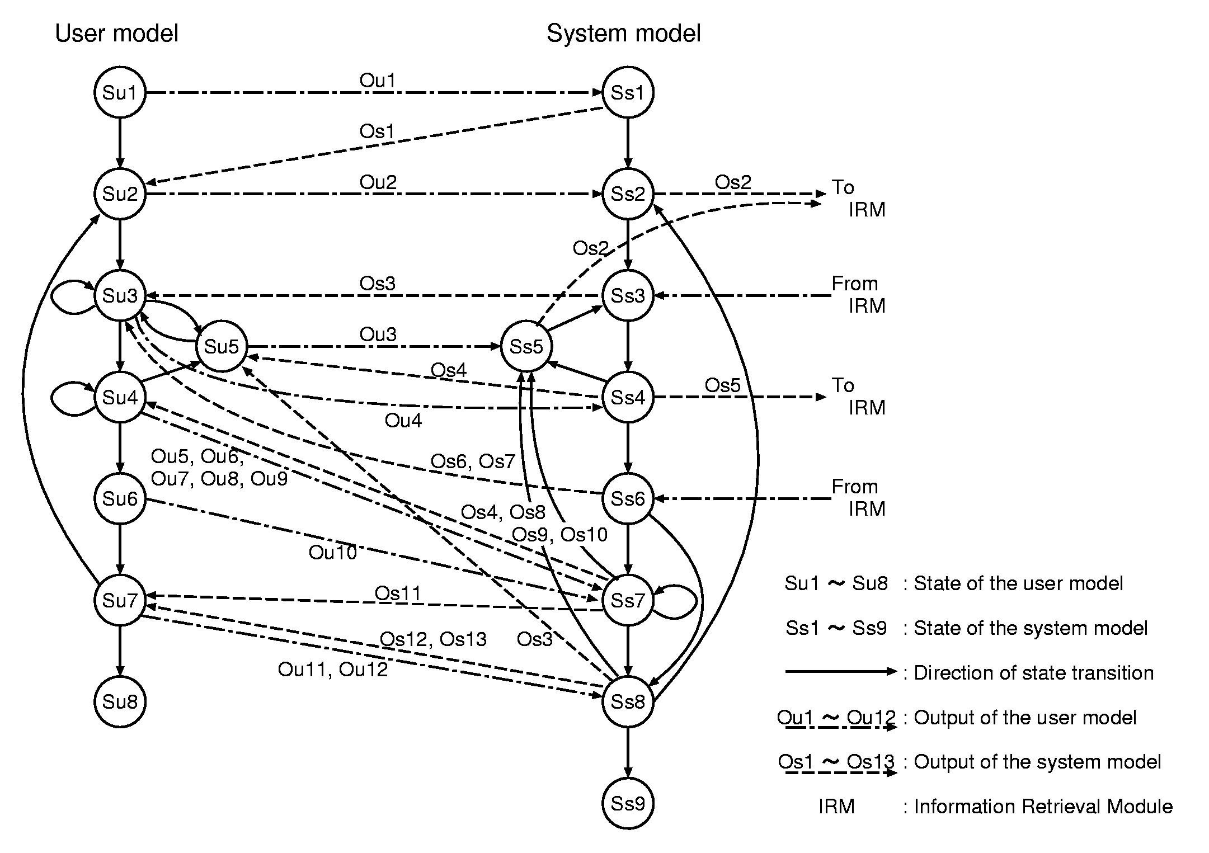
The User Model and the System Model Constructed on the Basis of Analysis of the Dialogue Corpus
© Hiroya Fujisaki

Slide 47

Model for Spoken Message Generation Used in Automatic Recognition of User’s Utterances
(Fujisaki 2001)
© Hiroya Fujisaki

Slide 48
Procedures for Model Comparison
For the purpose of quantitative comparison, the following
word bigram models were constructed, and their perplexities
were calculated.
(1) an average bigram model, constructed from a 20,000 word
vocabulary used in the Mainichi Newspaper (IPA, 2000)
(2) a topic-adapted model produced from a corpus of spoken
dialogues for academic information retrieval.
(3) a set of state-specific word bigram models constructed
from users’ utterances from the corpus of 100 dialogues.
© Hiroya Fujisaki

Slide 49
Perplexities of Word Bigram Models
Bigram model Perplexity
Average bigram model 83.72
Topic-specific bigram model 19.25
State-specific bigram models
User state Su1 5.55
User state Su2 29.90
User state Su3 6.06
User state Su4 30.75
User state Su5 11.78
User state Su6 7.74
User state Su7 7.42
Weighted mean of Su1～Su7 17.57
© Hiroya Fujisaki

Slide 50
Word Recognition Rate/Error Rate for the Three Models
Language model Word recognition rate error rate
Average model 73.2 % 26.8 %
Topic-specific model 93.2 % 6.8 %
State-specific models 95.7 % 4.3 %
© Hiroya Fujisaki

Slide 51
From Language Models to Mind Models
Language Models
N-gram models, Markov models
Context-dependent models (local adaptation)
Topic-dependent models (global adaptation)
Speaker-dependent models (speaker adaptation)
Mind Models should comprise
Models of the speaker, the listener,
the situation, and the world.
© Hiroya Fujisaki

Slide 52
Dedication
The talk is dedicated to the memory of my dear and respected friend of more than half a century, the late Fred Jelinek, pioneer of the
sｔatistical method of automatic speech recognition, which remained to be the leading principle of the modern technology of ASR for more than three decades.
My respect to him is unchanged in spite of the criticism stated in my talk.
© Hiroya Fujisaki

Slide 53
Thank you for your attention !

